Slide 1
WMCA x Groundwork
Climate Adaptation and Community Action -
Resource Pack

Slide 2
Context
In Spring 2025 the WMCA Community and Adaptation team, Groundwork South and Groundwork West Midlands collaborated to deliver a climate adaptation community action workshop series to West Midland Community Groups.
The workshops, delivered in person at the Birmingham Eco Park, focused on climate risk, climate adaptation and what this means for the West Midlands.
The interactive sessions generated practical actions and pledges for the attendees to take away to integrate into their day to day lives and ongoing work with their communities.
This resource pack brings together the workshop content and activities to support wider West Midlands communities to develop climate adaptation actions and solutions for themselves.

Slide 3


Introducing Groundwork
Alice Moorcroft-Hughes
Communities Prepared (Groundwork South)
Jack Holmes
Groundwork West Midlands
Communities Prepared is a Groundwork South programme delivering community resilience and multi hazard training and workshops across England. Find out more on our webpage, sign up to our newsletter or come to a free delivery session on Zoom, via our events page.
https://www.communitiesprepared.org.uk/
Groundwork West Midlands are a charity that operates across the West Midlands, supporting people and organisations through a variety of projects.
Find more information on our website: https://www.groundwork.org.uk/westmidlands/

Slide 4
Content
Part 1: Introducing Climate Adaptation
What is climate risk?
What climate risks impact the West Midlands?
What is climate adaptation?
Climate risk West Midlands case studies
Part 2: Actions Your Community Could Take
Climate adaptation West Midlands case studies
Example of community climate adaptation initiative from BME United
Activity:
Mapping climate risks and impacts for your community
Mapping climate adaptation solutions
Making a pledge for climate adaptation action
Resources:
Community organisations engaged in climate adaptation
Links for further exploration
Get in touch
Climate Adaptation
Activities
Resources

Slide 5
Part 1:
Introducing Climate Adaptation

Slide 6
What is Climate Risk?

Slide 7
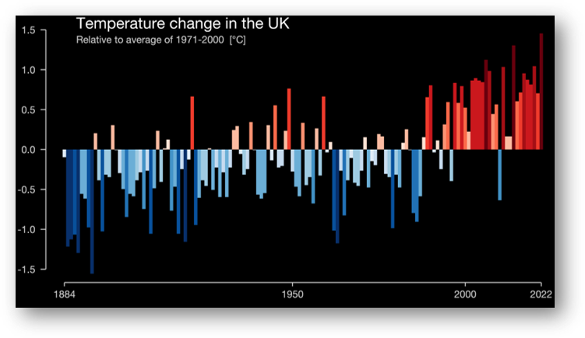
Our climate is changing
Severe weather is becoming more severe, more frequent and lasting longer
We are experiencing:
Warmer wetter winters
Hotter drier summers
More extreme weather events
The Show Your Stripes project shows the historic temperature change in the UK, with the last 2 decades highlighting the increase in hotter temperatures and decrease in colder temperatures we are experiencing.
Source: https://showyourstripes.info/c/europe/unitedkingdom/all/

Slide 8
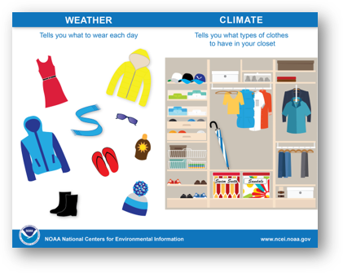
Weather vs. Climate
When we think about climate and climate risks, we need to understand how this is different from the weather.
The weather tells us what to wear each day. We all check the weather to find out if we need an extra layer, an umbrella, our sunglasses (or all three!).
The climate can be thought of as the wardrobe or cupboard that brings together all these clothes, these types of weather.
Source: https://www.ncei.noaa.gov/news/weather-vs-climate

Slide 9
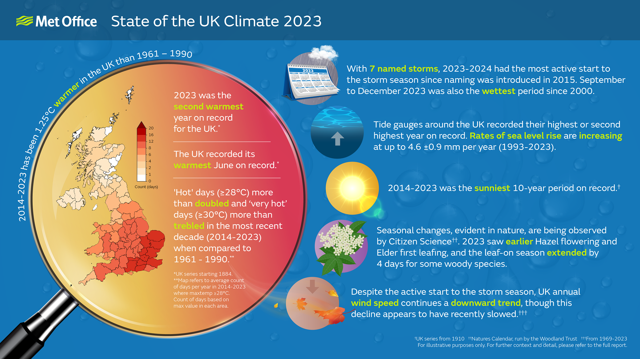
Source: https://www.metoffice.gov.uk/binaries/content/gallery/metofficegovuk/images/research/climate/uk-state-of-climate/state_of_uk_climate_2023_web.png
Notes:
https://www.metoffice.gov.uk/binaries/content/gallery/metofficegovuk/images/research/climate/uk-state-of-climate/state_of_uk_climate_2023_web.png

Slide 10




Impacts of Climate Change
Climate change is having a range of impacts on us as individuals, as communities and on society in general. Different people are impacted differently, sometimes referred to as a vulnerability. This could be based on their age, their health or more broadly the type of impact they are facing.
Climate change causes risks to life. The record-breaking heatwave in 2022 saw several thousand people lose their lives from the impacts of the extreme heat.
Loss of property and belongings in floods, which can be long term impacts, taking many years to resolve. The issue extends to services and businesses.
Infrastructure damage, phone lines, power cables, leading to power outages, loss of communication. Also damage to buildings and infrastructure have huge economic consequences.
Loss of natural environment, damage to trees, landscape, increasing vulnerabilities of people and their environments.

Slide 11
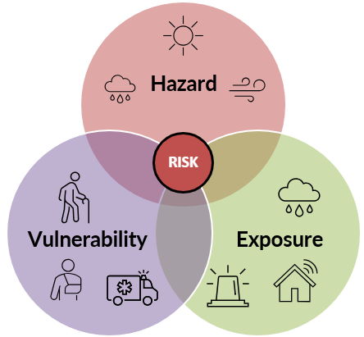
Climate Risk
Hazard x Exposure x Vulnerability = Risk
Our changing climate seeing an increase in hazards such as floods, heatwaves, storms.
Our exposure to these hazards, whether that be flooded properties or experiencing a heatwave.
Our vulnerabilities to these impacts, such as health challenges or economic challenges.
All these elements combined, form climate risk and it is these risks, and these challenges that we need to be prepared for in the future and we are going to explore how we can adapt to.

Slide 12
What climate risks impact the West Midlands?

Slide 13
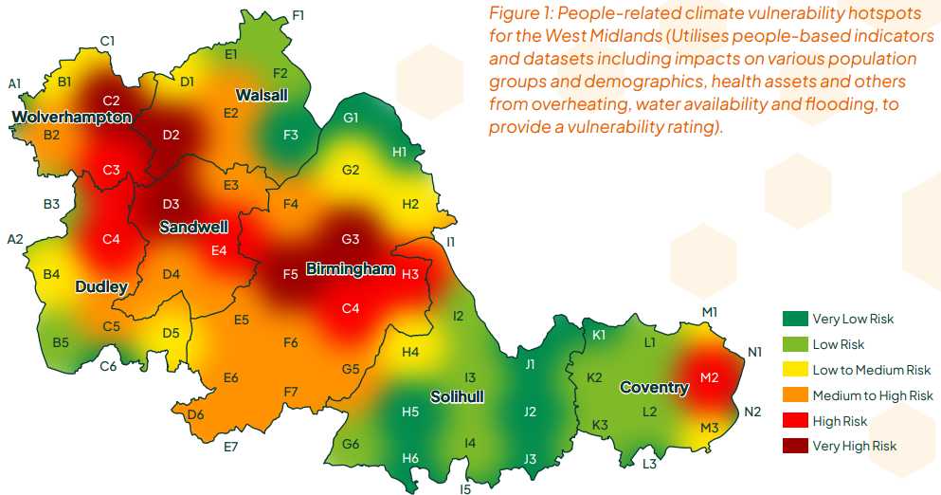
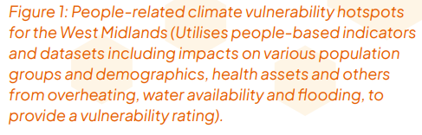
Climate Vulnerability Hotspots
This map of the WMCA region shows an implementation of the earlier formula Hazard x Exposure x Vulnerability = Risk
Most urbanised areas are most at risk
Source: https://www.wmca.org.uk/media/d2pons0q/summary-of-climate-change-impacts-in-wmca-area.pdf

Slide 14
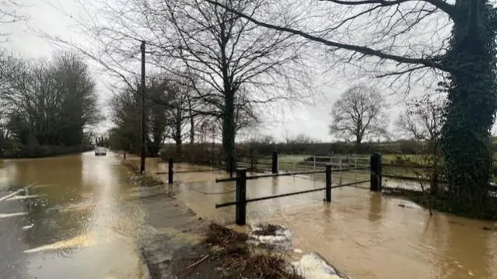
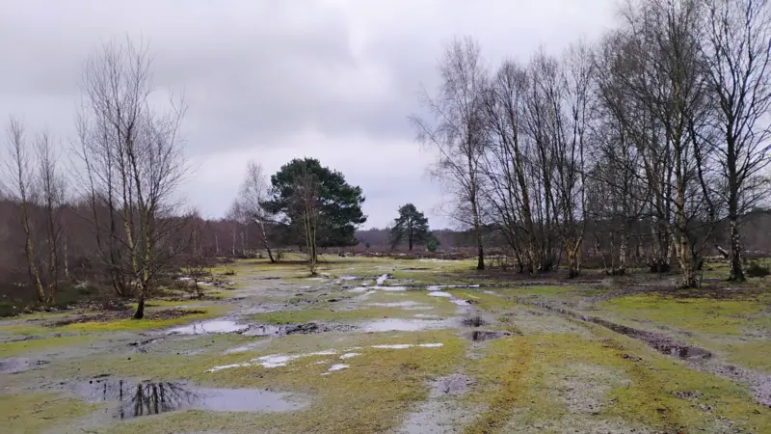
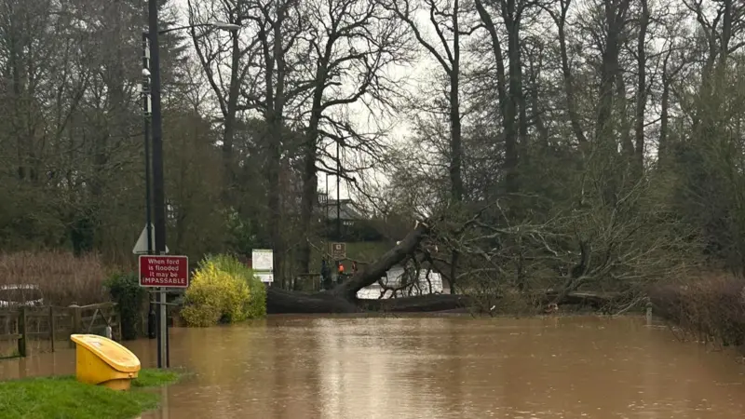
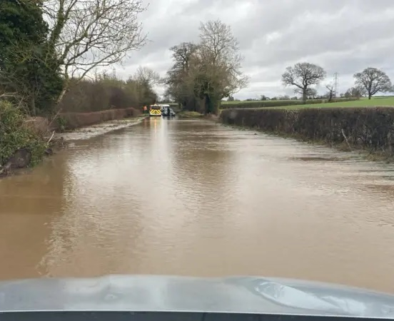
West Midlands Flooding
Severe flooding after 3 back-to-back storms in 2022 (Dudley, Eunice and Franklin)
Flooding after storms, during heatwave in 2023
3 times average rainfall in September 2024 saw flash flooding, severe travel disruption, road closures
5-6th January 2025, yellow weather warning for snow and ice. 36 flood warnings in place across West Midlands. School closures, road closures, more than 1,500 properties without power
Costs of the 2023 August Flash Flooding: £2,791,130
Sources:
https://www.bbc.co.uk/news/live/cwy84yxpy1dt
https://www.theguardian.com/environment/2022/feb/23/danger-to-life-warnings-in-west-midlands-after-flooding
https://www.bbc.co.uk/news/uk-england-birmingham-65881121
https://www.bbc.co.uk/news/live/cn4zgevp3n7t

Slide 15
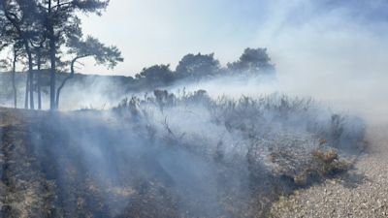
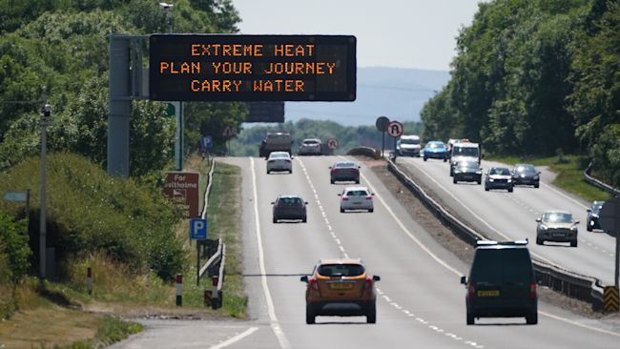
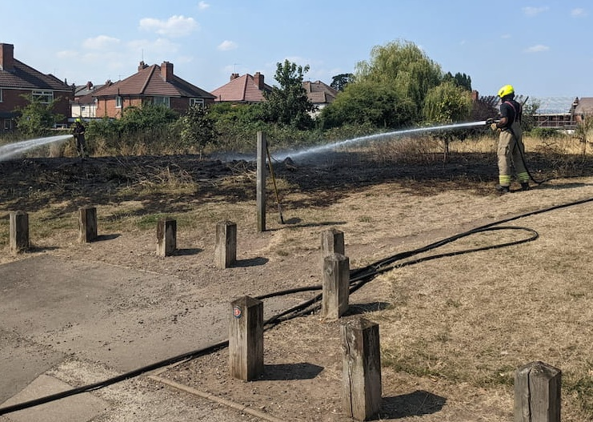
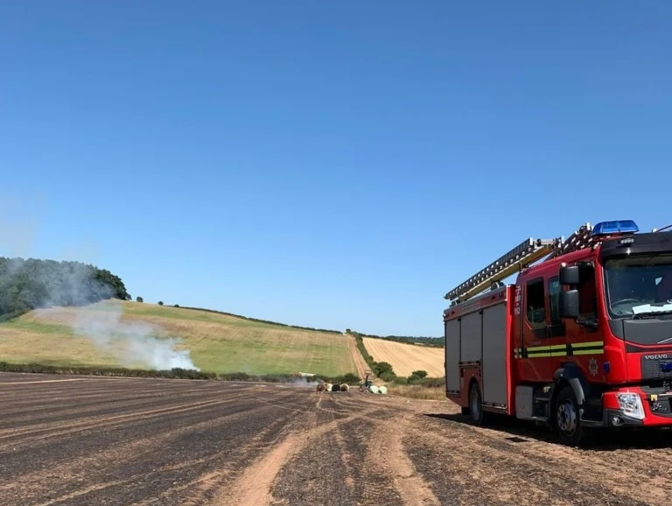
West Midlands Heatwaves
July 2022 unprecedented temperatures exceeding 38°C
Widespread disruptions including overheating in homes, school closures, travel chaos, and increased emergency incidents.
WMR Delays due to heat damage to tracks and electrical cables A14 closed for hours
Huge fires in Country Parks and at Lickey Hills
Cost of the Jul/Aug 2022 heatwave: £11, 805, 340
Sources:
https://www.birmingham.ac.uk/news/2025/university-of-birmingham-and-wmca-join-forces-to-combat-impact-of-climate-change-in-west-midlands
https://www.bbc.co.uk/news/uk-england-birmingham-62237776
https://www.bbc.co.uk/news/uk-england-hereford-worcester-62499311
https://www.bbc.co.uk/news/uk-england-coventry-warwickshire-62241966
https://www.bbc.co.uk/news/uk-england-cambridgeshire-62219162
https://www.wmfs.net/news/from-fires-to-flood-warnings/

Slide 16
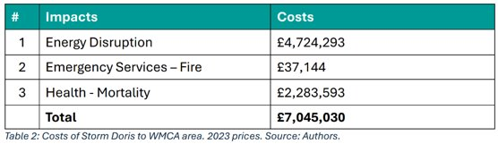
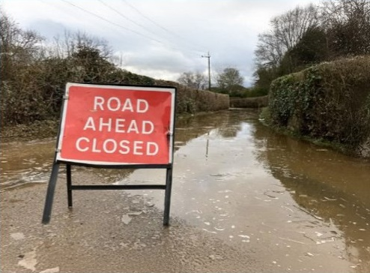
Case Study 1 – Storm Doris
60 mph winds were recorded in the Black Country.
Rail travel was totally advised against.
Fallen trees across the region further adding to disruption.
At least 8 B roads closed along with part of the M5.
15 million customer hours of electricity lost.
WM Ambulance Service responded to 202 incidents in 1 hour. A 43% increase on the previous day for the same time period.
Source: https://www.wmca.org.uk/media/d2pons0q/summary-of-climate-change-impacts-in-wmca-area.pdf

Slide 17
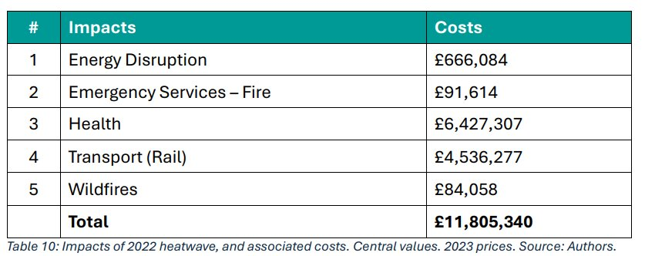
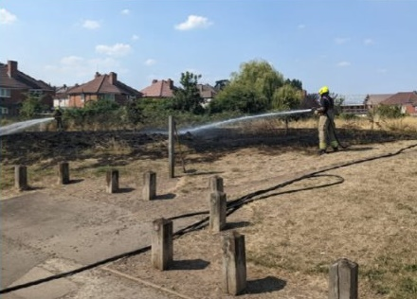
Case Study 2 – August 2022 Heatwaves
Red warning and amber warning in the space of 1 month
Train services cancelled
Infrastructure unable to cope
125 grid faults affecting 46,225 customers
A battery recycling park was monitored due to serious fire risk
100 excess deaths
Source: https://www.wmca.org.uk/media/d2pons0q/summary-of-climate-change-impacts-in-wmca-area.pdf

Slide 18
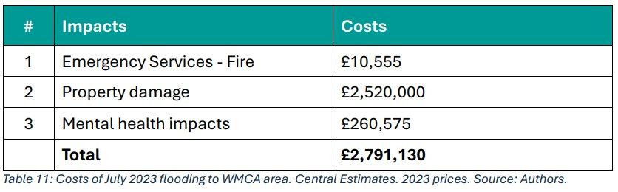
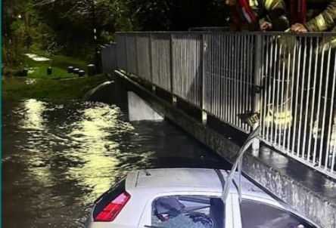
Case Study 3 – Summer 2023 Floods
Sixth wettest July on record
Roads flooded across WMCA
Businesses shut due to floods
At least 80 properties flooded
This was only during a yellow weather warning
We have seen red weather warnings towards the end of last year in other areas of England
Floods due to storm weather are happening more frequently
Source: https://www.wmca.org.uk/media/d2pons0q/summary-of-climate-change-impacts-in-wmca-area.pdf

Slide 19







West Midlands by 2050
Summer rainfall could dec. by 15% by 2050s
Winter rainfall could inc. by 6% by 2050s
Temperatures could inc. by 1.2°C by 2050s
Inc. health inequalities
Risk of water scarcity by 2050s
Inc. risk of wildfires
Higher pollution
Without effective adaptation, the socio-economic impacts of climate change are likely to escalate, potentially reducing the region’s Gross Value Added (GVA) - the value of goods and services - between £1.5 billion - £2.9 billion per year by 2050.
Notes:
https://www.sustainabilitywestmidlands.org.uk/wp-content/uploads/2023/12/West-Midlands-Climate-Change-Risk-Assmt-Adaptation-Plan-2021-26.pdf
https://www.birmingham.ac.uk/news/2025/university-of-birmingham-and-wmca-join-forces-to-combat-impact-of-climate-change-in-west-midlands
https://www.wmca.org.uk/media/d2pons0q/summary-of-climate-change-impacts-in-wmca-area.pdf

Slide 20
What is Climate Adaptation?

Slide 21
Actions we can take to reduce the risk and impact of climate change
Climate Adaptation
Understand how climate change will impact us now and prepare for the future
Improve our communities, making them greener, safer, healthier
Make changes in personal, communities, and wider society

Slide 22
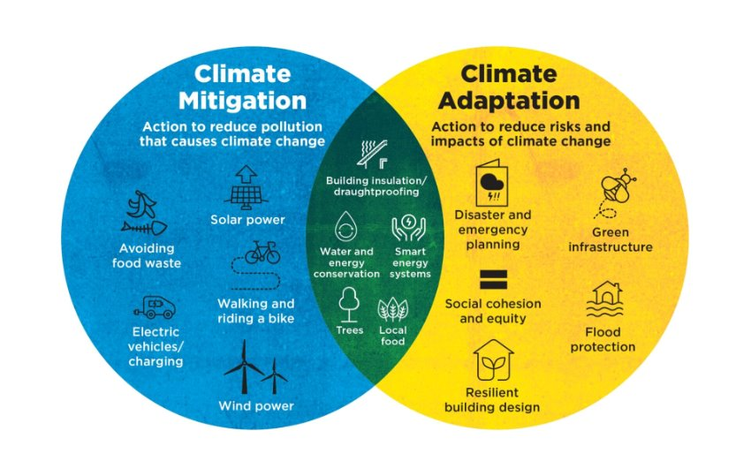
Mitigation or Adaptation
Climate adaptation looks at the actions to reduce risks and impacts e.g. flood protections.
Climate mitigation is actions to reduce pollution that causes climate change e.g. green sources of energy.
There is cross over between the two, such as water and energy conservation, and often they get confused due to how closely linked they are.
For example, insulation a home both protects it from overheating but also reduces energy demands for heating/cooling.
Source: https://www.cilips.org.uk/gwl-adapt

Slide 23
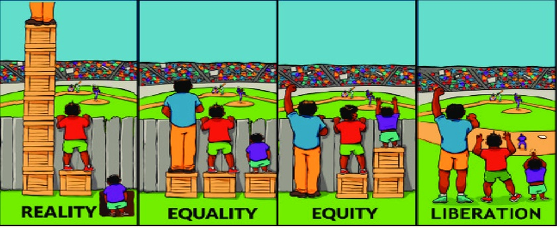
Socially Just Adaptation
Climate change impacts are unequally distributed, with marginalised and vulnerable communities the most impacted
Socially just adaption is centred on solutions, understanding who are the most impacted, and how their needs can be met
When thinking about climate adaptation, we need to make sure that it is socially just, that it is inclusive, and recognises different experiences and needs.
Source: https://www.internationalwomensday.com/Missions/18707/Equality-versus-Equity-What-s-the-difference-as-we-EmbraceEquity-for-IWD-2023-and-beyond

Slide 24
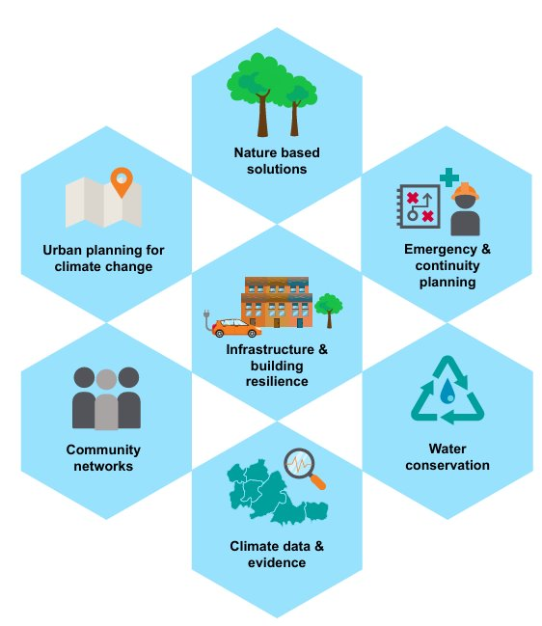
Possible Adaptation Solutions
Resilient building design:
Homes designed for heat, insulated for cold.
Community action & awareness raising
Attend sessions like WMCA's training, spread the word.
Nature based solutions:
Tree planting, rain gardens, water conservation e.g. water butts in gardens.
Property level flood protections
Raised electrical sockets, flood barriers.
Sustainable Urban Drainage systems
Manage water runoff in a more sustainable way.
Source: https://www.wmca.org.uk/media/d2pons0q/summary-of-climate-change-impacts-in-wmca-area.pdf

Slide 25
Total economic cost - £21,641,500
Impacts are connected
Higher frequency means less time for recovery between events
Impacts Summary

Slide 26
Part 2:
Community Adaptation Action

Slide 27
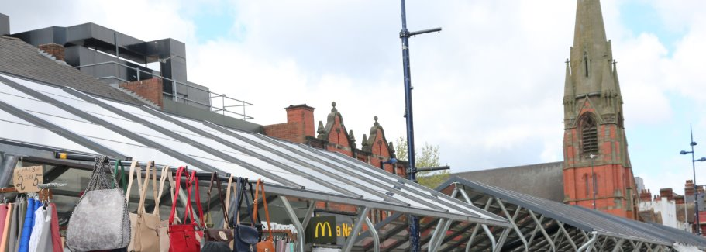
Case Study 1 – Adapting West Bromwich Outdoor Market
Installation of solar PV (photovoltaic) panels on the market, at project cost of £467,000
An example of both mitigation and adaptation
Solar PV panels reduce the heat gain during heatwaves, by reflecting and absorbing heat.
Weatherproofing was also installed to reduce strong winds discovered while work was being done on site
Source: https://www.sustainabilitywestmidlands.org.uk/wp-content/uploads/2023/12/Climate-change-adaptation-practical-examples-for-local-authorities-.pdf
Image source: https://www.local.gov.uk/case-studies/sandwell-metropolitan-borough-council-urban-greening-west-bromwich-outdoor-market#:~:text=The%20West%20Bromwich%20outdoor%20market,heart%20of%20the%20town%20centre.

Slide 28
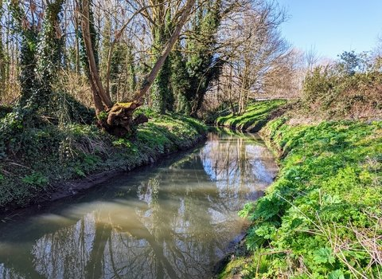
Case Study 2 – Badsey Brook Flood Alleviation and River Cleanup
Large scale adaptation project highlights the scale of some adaptation needs, costing up to £4.1 million
Storage area holding 135,000 cubic meters of water
At the community level: Love Your River
River cleanup, removing litter and invasive species such as Himalayan balsam
Implementing urban catchment areas and managing them
Conservation and protection of wildlife
Reducing the silt level in rivers, improving flow rate of the water reducing the flood risk
Source: https://www.sustainabilitywestmidlands.org.uk/wp-content/uploads/2023/12/Climate-change-adaptation-practical-examples-for-local-authorities-.pdf
Image source: https://www.bbcwildlife.org.uk/LoveYourRiverStour

Slide 29
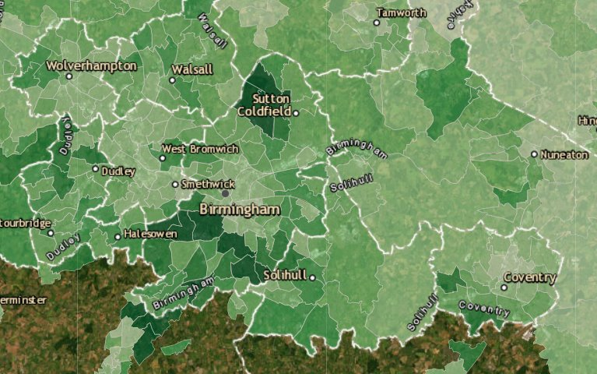
Case Study 3 – Urban Heat Islands
An example from Cambridge; Canopy Project
Aim to increase urban tree coverage from 17% to 19%
2,000 locations identified to plant trees
Trees gifted to residents
Engagement projects through community organisations
City centre/industrial areas can be as low as 13.5% in the WMCA region, further exacerbating existing issues during heatwaves
Source: https://www.sustainabilitywestmidlands.org.uk/wp-content/uploads/2023/12/Climate-change-adaptation-practical-examples-for-local-authorities-.pdf
Image is a screenshot taken from: https://forestry.maps.arcgis.com/apps/webappviewer/index.html?id=d8c253ab17e1412586d9774d1a09fa07

Slide 30
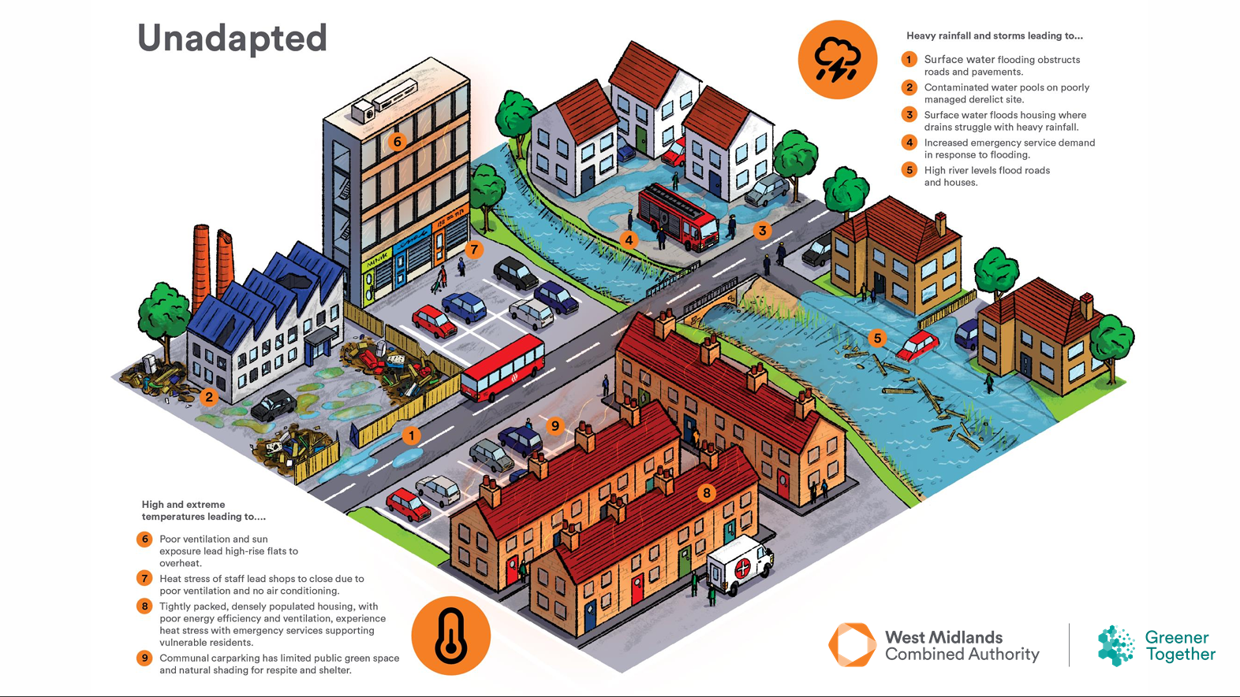
If we carry on as normal and do not adapt to our changing climate, this is what the west midlands could experience

Slide 31
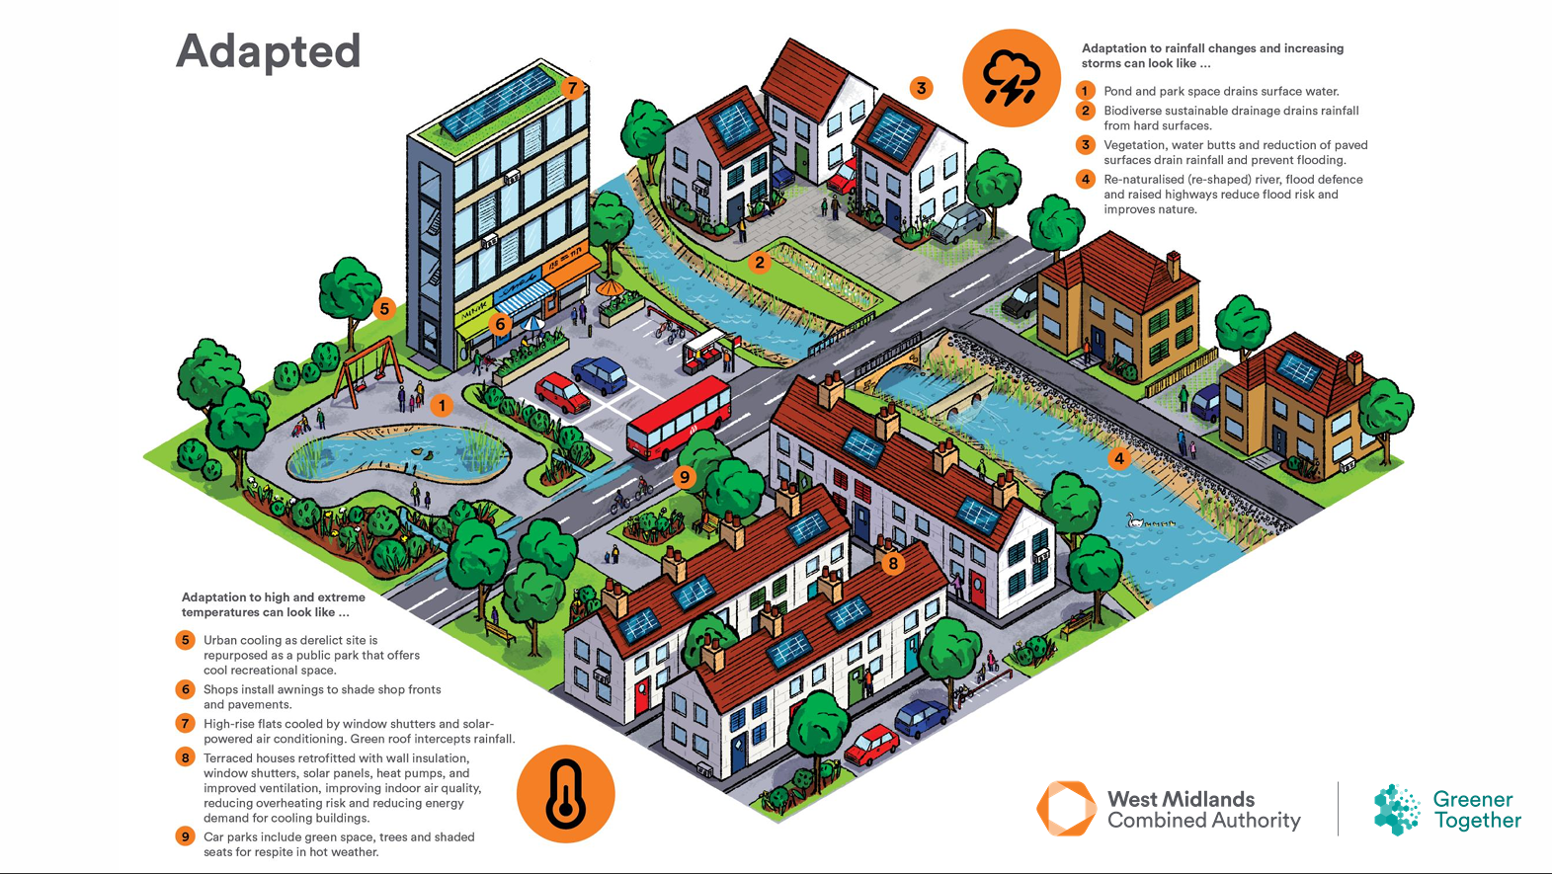
But if we do adapt to our changing climate, we can take any of the below measures to improve our living environment for our communities

Slide 32
An example of Community Climate Adaption initiatives

Slide 33

“Together We Can Make Difference”
Empowering Communities Through Climate Adaptation
Notes:
Introduction- Today, we will be sharing insights from our Climate Adaptation Project “ Together We Can Make Difference”, which focused on raising awareness and equipping communities with tools to adapt to climate change.
Climate change affects us all, but vulnerable communities often bear the greatest impact. Our goal with this project was not just education but real action—helping people build resilience and prepare for the future.

Slide 34

Who We Are
BME United Ltd:
A charity and company limited by guarantee.
20+ years empowering disadvantaged communities in Wolverhampton & West Midlands.
Focused on grassroots engagement, cultural sensitivity, and multi-lingual facilitation.
Notes:
To start, let me tell you a little bit about the organisation we work for:
BME United Ltd is a registered charity and a company that has been serving Wolverhampton and West Midlands areas for over 20 years.
We focus on supporting people who are often overlooked, especially those from disadvantaged backgrounds or hard-to-reach communities.
Our mission is to provide them with the tools, knowledge, and resources they need to build resilience.
Our work is based on grassroots engagement—we listen to them, understand their concerns, and work together to find the best solutions.
Many of the people we work with face barriers such as language difficulties or lack of access to mainstream services, so we take a culturally sensitive and multi-lingual approach to our work.

Slide 35

Why Climate Adaptation
🌍 Why It Matters:
Extreme weather events (floods, heatwaves, storms) are increasing.
The most vulnerable communities are at risk.
Notes:
Climate change is no longer a distant threat; we are seeing its effects right here in our local communities.
Increased flooding and extreme weather events are impacting homes and livelihoods.
On a global scale, floods, droughts, and disasters are becoming more frequent and severe.
Despite this urgency, many people don’t know what climate adaptation is or how to prepare for these changes. Our goal was to bridge that gap—raising awareness and providing people with practical steps they can take to protect themselves and the people around them.
Less than 1% of the Earth's water is drinkable, a fact that often goes unnoticed. Learning this has inspired many to make small but meaningful changes in their daily lives, such as conserving water, fixing leaks, and using water-efficient appliances. These simple actions contribute to a larger effort in climate adaptation and saving natural resources.

Slide 36
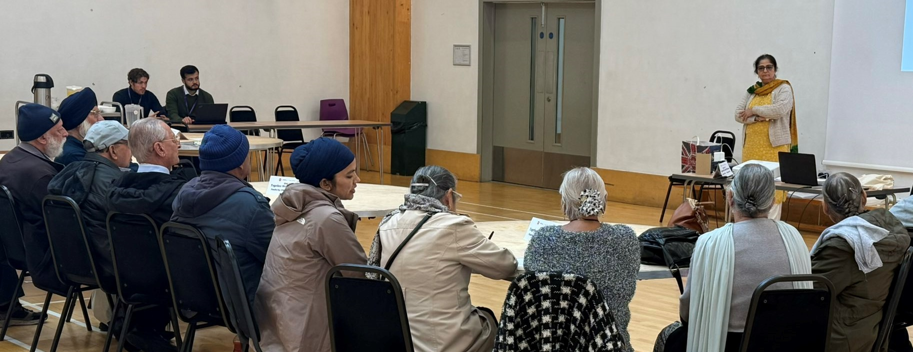
Project Overview
📊 What We Did:
17 workshops → 316 participants
Community hubs, Gurdwaras, local centres
100% Asian participants (277 evaluations completed)
81.59% aged 61-80
90.61% female
Notes:
We delivered workshops to 17 community groups, reaching a total of 316 participants.
To ensure accessibility, we hosted these sessions in familiar local spaces, including faith establishments and community centres - This approach was essential in reaching individuals who might not otherwise have access to this critical information.
Our participants were from Asian backgrounds
Over 81% aged 61-80—people who are especially vulnerable to extreme weather events. Engaging them in climate resilience strategies was a key priority.
More than 90% of our participants were women, Their involvement was crucial, so it was very important to educate and support them with the right skills and knowledge as they often take the lead in implementing practical climate adaptation measures at home.

Slide 37
Baseline Assessment
📉 Before Our Workshops:
❌ 83.39% didn’t know about extreme weather risks
❌ 84.84% didn’t know how to prepare
❌ 97.11% didn’t know where to get help
✅ 95.67% were willing to take action
Notes:
Before the workshops, we conducted evaluations to assess participants' awareness of climate risks. The findings were striking:
Over 83% were unaware of the risks posed by extreme weather.
85% did not know how to prepare for climate-related emergencies.
Nearly 97% had no knowledge of where to seek help in the event of a climate-related disaster.
Despite this lack of awareness, an overwhelming 96% expressed a willingness to take action once equipped with the right information.
These results highlighted a significant gap in knowledge but also a strong desire for change—reinforcing the importance of providing accessible education and practical tools for climate adaptation.

Slide 38
Post-Evaluation
📈 After the Workshops:
✅ 98.55% found it useful
✅ 96.02% aware of extreme weather risks (was 16% before)
✅ 93.14% now know how to prepare
✅ 97.47% feel confident to act
Notes:
The impact of the workshops was clear, with a significant shift in awareness and confidence:
98.5% of participants found the workshop useful and informative.
Awareness of extreme weather risks increased from 16% to 96%.
93% gained a clear understanding of the steps needed to prepare for climate-related events.
Nearly 97.5% felt confident in their ability to take action.
These results demonstrate the effectiveness of grassroots education—when people are engaged in the right way, they respond with enthusiasm and a commitment to change.

Slide 39

Outcome
Community Actions:
✅ 92 pledges for water conservation
✅ 109 pledges to reduce flood risk
✅ 4 new volunteers joined us and 6 peer mentors were trained
✅ 100 trees distributed, 3 planted in public spaces
✅ Punjabi radio program on climate adaptation
Notes:
Beyond raising awareness, our goal was to inspire real action—and the results speak for themselves.
Participants made 92 pledges to conserve water and 109 commitments to reducing flood risk.
The project also led to the creation of four new volunteering opportunities and the training of six peer mentors, empowering the community to take climate action further.
As part of our efforts, we distributed 100 trees, three of which were planted in community spaces, contributing to local environmental improvements.
To extend our reach even further, one of our climate peer mentors, who is also a radio presenter at Gulshan Radio, spoke about climate adaptation on a radio program, ensuring that important information reached a wider audience beyond the workshop participants.
These outcomes highlight the power of grassroots initiatives in creating lasting change. As one participant shared, "This session greatly improved our awareness of climate change and its consequences. It made me more mindful of my daily activities and how they can contribute to protecting the environment”

Slide 40
Overcoming Challenges Through Community Engagement
💡 Key Strategies for Success:
✔ Peer Mentors: Trusted community members helped deliver key messages, making learning more relatable and impactful.
✔ Interactive Activities: Workshops included games, discussions, and hands-on exercises like Kahoot! to make learning engaging and fun.
✔ Multi-Lingual Support: Staff and volunteers delivered sessions in Punjabi, Urdu, Hindi, and other community languages, ensuring everyone could participate fully.
✔ Translated Resources: Participants received handouts, guides, and emergency preparedness checklists in multiple languages to aid understanding.
Notes:
One of our biggest challenges was engaging older community members and overcoming language barriers. Many participants felt disconnected from climate issues simply because resources weren’t available in their language. To bridge this gap, we used several key strategies that proved to be highly effective.
First, we recruited peer mentors from within the community—trusted individuals who could communicate in familiar ways and encourage participation. This approach was particularly impactful for older attendees who felt more comfortable speaking in their native language. When information came from someone they knew and respected, they were far more likely to engage.
We also made learning interactive and fun by incorporating activities like Kahoot! Quizzes and group discussions Many participants had never considered climate risks before, but once they tested their knowledge in a game, they became eager to learn more.
Another major success factor was having multi-lingual staff and volunteers. Workshops were delivered in Punjabi, Urdu, Hindi and English ensuring that every participant felt included. This not only improved understanding but also encouraged people to ask questions in their own language.
Beyond the sessions, we provided translated materials, including climate action guides and emergency preparedness resources, so participants could continue learning.
By combining these strategies—peer mentors, interactive learning, and multilingual support—we broke down barriers and made climate adaptation accessible and engaging for the entire community

Slide 41
Community Feedback
📢 What People Said:
💬 "The session was eye-opening and made me realise the importance of taking action now."
💬 "I gained valuable insights on how to reduce flood risks and safeguard my family."
📌 Most Common Request:
👉 251 participants asked for ongoing awareness sessions
Notes:
One of the most rewarding parts of this project was hearing directly from participants. Many shared how the workshops changed their perspective,
with one attendee saying, "The session was eye-opening and made me realise the importance of taking action now."
Another participant added, "I learned practical steps to reduce flood risks and protect my community."
This kind of feedback highlights the real impact of our work and reinforces the need for continued education.
The demand is clear—251 participants requested ongoing awareness sessions, showing a strong desire to keep learning and taking action.

Slide 42
Why This Matters
🌍 Impact on Our Community:
✔ People are more aware and prepared
✔ More families are taking climate action
🚀 Big Picture:
This project shows how grassroots engagement can drive real change
If we all take action, we can build a climate-resilient future!
Notes:
Why these sort of project matter?
These sort of projects matters because It’s more than just education—it’s about empowerment.
Participants left our workshops feeling confident and prepared, ready to take action in their own lives.
This project also highlights the power of grassroots engagement. When we work directly with communities, we see real change. Climate adaptation is essential for everyone, but especially for vulnerable groups. Our work proves that when people have access to the right resources, they step up, take action, and become part of the solution.

Slide 43

Key Takeaways
✅ Engage directly with local groups
✅ Use culturally sensitive methods
✅ Recruit peer mentors to spread awareness
Notes:
What we have learnt is that:
Engage directly with communities: Meeting people where they already gather—whether in community groups or faith establishments—made a huge difference in fostering participation.
Use culturally sensitive and interactive methods: Incorporating games, group discussions, and peer mentors helped break down barriers and keep people actively engaged.
Foster a sense of ownership and responsibility: Encouraging participants to take leadership roles, such as becoming peer mentors, deepened their commitment and made them active agents of change in their communities.
These lessons aren’t just relevant to climate adaptation—they can be applied to any community-based project, highlighting the importance of building sustained relationships and empowering individuals to take ownership of the process.

Slide 44
Thank You
Contact Information:
Arslan Butt & Neena Bilku
Email: arslan@bmeunitedltd.co.uk, neena@bmeunitedltd.co.uk
Tel: 01902772600
Web: www.bmeunitedltd.co.uk
Twitter: @BMEUNITEDLTD
Notes:
A big thank to our funder WMCA which made this project possible.
Together, we can continue making a difference. Thank you!

Slide 45
Part 3:
Activities

Slide 46
Activities
The following pages will help you put the learning and insights from parts 1 and 2 into practice in your local area and community. Working on these activities collectively is a great way to collaborate, share ideas, hear different perspectives and expand your adaptation reach and impact.
The conversation starters can help get you started by having discussions or brainstorming sessions on the topic.
Activity 1 focuses on exploring climate risks and impacts in your local area, so that you have a localised and specific focus for your adaptation action plan.
Activity 2 focuses on developing your action plan based on the climate risks and impacts your explored, helping you find ways to be better prepared or reduce the impacts all together.
Making a pledge brings the learning and activities together to help you move forward with a tangible, achievable climate adaptation action that will benefit you, your community and surrounding area.
Mapping Risks & Impacts
Adaptation Action Plan
Making a Pledge

Slide 47
Conversation starters
Use these questions to help get conversations started with your family, friends or community groups. It can help to think about climate adaptation collectively, so that you are working together to a shared goal.
What climate risks are you aware of?
Are you concerned about?
Have you experienced?
What are you and your communities already doing to prepare for or adapt to climate change?
What weather events have impacted your community in recent years?
What could you have done to be better prepared?
What do we need to think about when developing climate adaptation solutions?

Slide 48
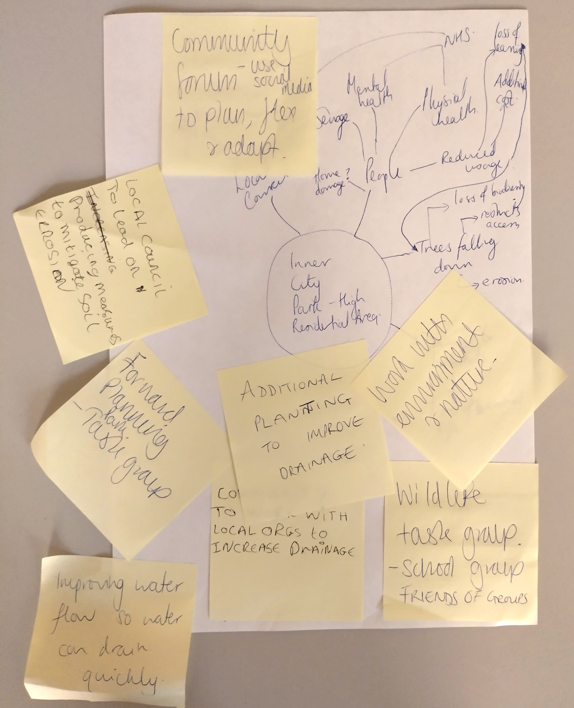
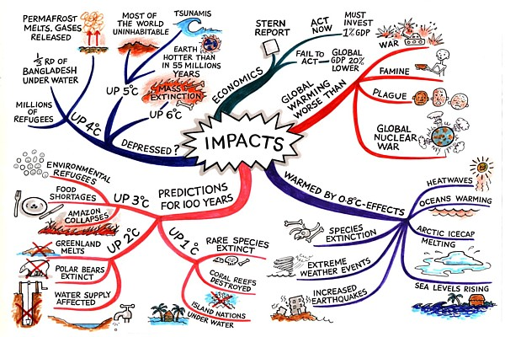
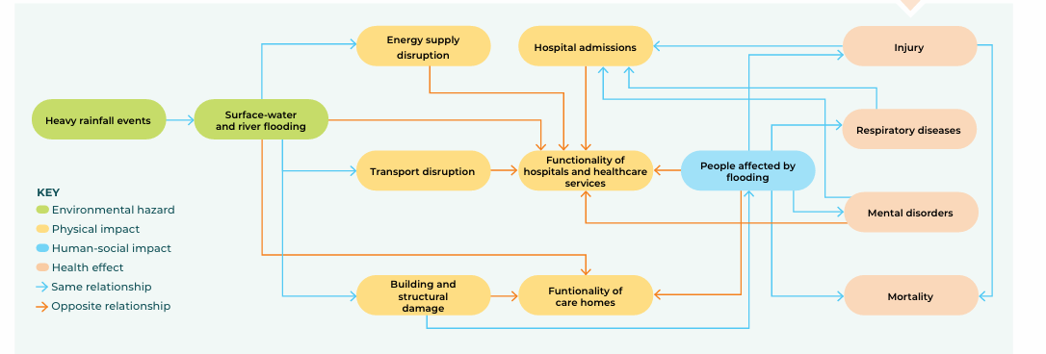
Activity 1: Mapping Climate Risk & Impacts
Now that you have explored climate risk and impacts in the West Midlands you can start to focus on your own community and develop a localised perspective.
Get together with a group, maybe your family and friends or with a local community group.
To make this a creative activity why not get some pens and paper, post it notes and stickers.
Choose an area to focus on, this could be your home, your street or local community space or a community asset like a park.
Pick 1 hazard (e.g. flood or heatwave) and think about 3-5 impacts on your community area.
Map them out in a flow chart/spider diagram and create links and connections between the impacts
Image sources:
Workshop outputs
https://images.reading.gov.uk/2025/05/OP006-Reading-Borough-Council-Climate-Change-Adaptation-Framework.pdf
https://www.mindmapart.com/climate-impacts-mind-map-jane-genovese/

Slide 49
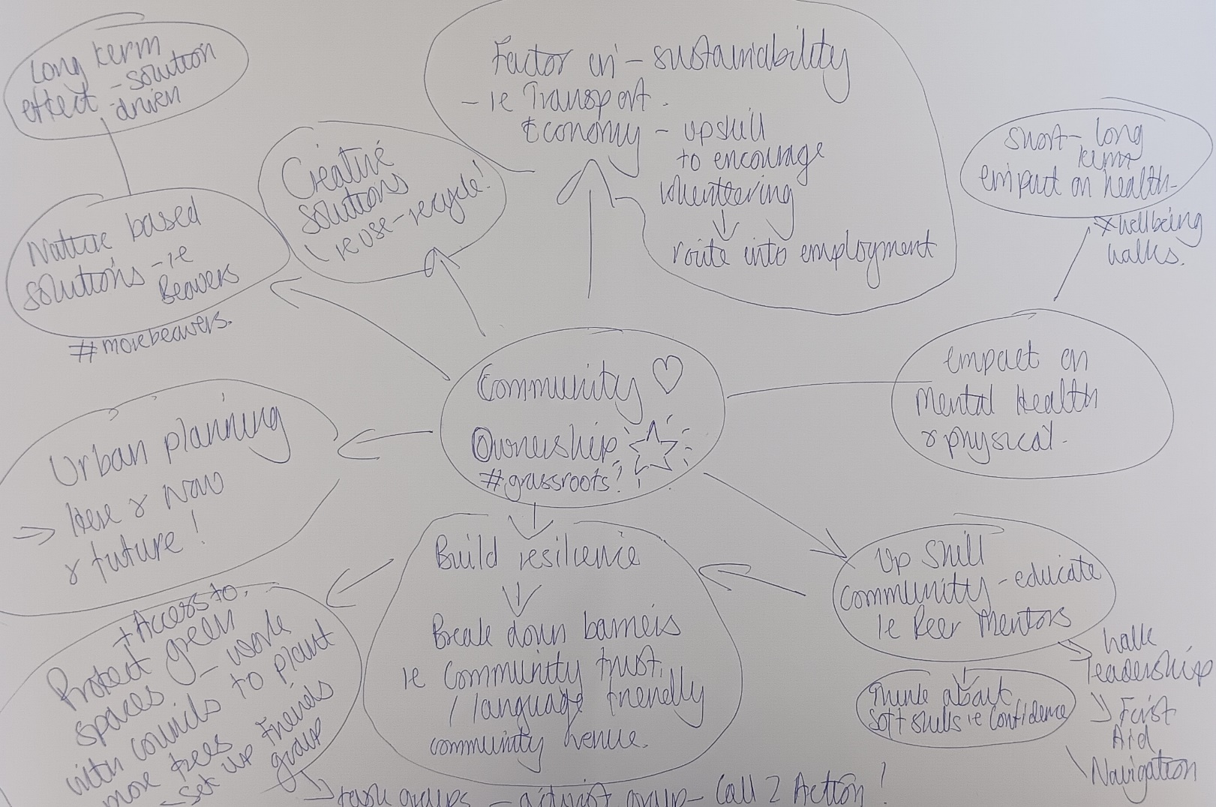
Activity 2: Adaptation Action Plans
Now that you have mapped climate risk and impacts for your chosen local area, you can start to identify adaptation actions to take that can help reduce them.
Look at the scenarios created in activity 1 and start to identify possible adaptation actions
Think about who would be involved, what would be needed, how to achieve and why it is important, to help sense check your ideas.
Try to organize these plans in a flow-chart style and look for connections and adaptation actions that can have a wide range of benefits.
Priorities the actions you want to take, perhaps those that have the most interconnected benefits or that you can do collectively as a community.
Image sources:
Workshop outputs
https://images.reading.gov.uk/2025/05/OP006-Reading-Borough-Council-Climate-Change-Adaptation-Framework.pdf
https://www.mindmapart.com/climate-impacts-mind-map-jane-genovese/

Slide 50
Activity 3: Make a pledge
To make your action plans more tangible and to help support you to put them into practice, make a pledge as a way to commit to an action that you will implement. You can start with something small and easy and then work up to something that takes more time and effort. Making a pledge shows your commitment to making a change and helps you put it into practice.
Things to consider when making a pledge:
What are you hoping to achieve?
What is the benefit of the change or action?
Is there a time frame to consider or will it be continuous?
Do you need to take any supporting actions to make it achievable?
How can you involve others?
How can you measure and celebrate progress or impact?
Writing down your pledge, putting it on the fridge, on your mirror or somewhere visible helps keep it active. You can explore possible pledges on the next page and use these for inspiration.

Slide 51
Activity 3: Possible Pledges
Use less water
Waste less food
Use car less
Reduce residential waste
Plant more trees
Increase knowledge in climate action and share with friends and family
To create awareness and educate people around my community about climate adaptation
Save rainwater for my garden
Engage with local black community on climate adaptation awareness
More engagement with local council on climate issues
Encourage peer mentors to step up and create ownership within community groups
Put even more food plants and biodiversity habitats into my tiny urban garden
Consider extreme weather as part of access working group and supporting before and during visits
Develop conversation around climate adaptation in longer term adaptation plans
(Community pledges created by workshop attendees)

Slide 52
Workshop Attendee Organisations
Organisation | Website
Ramblers | https://www.ramblers.org.uk/
The Active Wellbeing Society | https://theaws.co.uk/
Birmingham Botanical Gardens | https://birminghambotanicalgardens.org.uk/
Holyhead Road Allotments | https://www.neighbourly.com/project/670005206d3bde798c513931
Brushstrokes Community Project | https://www.brushstrokessandwell.org.uk/
Growth Path Services | https://www.growthpath.org.uk/
RyeCroft NRC | https://sites.google.com/a/ryecroftnrc.org/hub3/
Lifegate Outreach Centre | https://www.lifegatecentre.org/

Slide 53
Additional Resources
Link to the West Midlands Climate Risk and Vulnerability Assessment (CRVA) mapping for communities in the region
Guidance on the different types of nature-based sustainable drainage systems (NbSuDS)
Explore wider WMCA projects and initiatives: Adapting to Climate Change.
Sign up to the communities Prepared Newsletter, become a member or explore the events page for upcoming workshops and training sessions https://www.communitiesprepared.org.uk/events/
Sustainability West Midlands has a range of resources regarding sustainability, climate change and climate adaptation
Groundwork has a Sustainable Business Services offer which can support your organisation with further training, environmental assessments and reporting
You can look at the urban tree coverage across the country using the following link: Forestry Maps

Slide 54
Thank you

