Slide 1
Cost of living challenges and mental health
Ground to be covered
Purpose of the session
MH Commission re-cap
The relationship between financial wellbeing and mental health
Local context and feedback;
Emerging Commission ideas for action;

Slide 2
Cost of living challenges and mental health
MH Commission
HoTR
Core Group
Purpose fo the session:
To foster collaborative work between the Mental Health Commission and the Health of the Region Core Group to identify potential local / regional action that can be taken to support local people to ‘keep afloat’ during the cost of living challenges.
Local / regional actionable recommendations

Slide 3
Mental Health Commission – focus
A time-limited Mental Health Commission aims to ‘add value’ in pursuit of a mentally healthier region, building on existing local and national work, by:
Supporting a clear regional understanding of the differential mental health and wellbeing impacts of the COVID-19 pandemic on local people – at home, in education, at work and at play.
Understanding the response to the pandemic, particularly recognising and celebrating local innovation and good practice in supporting mental health & wellbeing;
Co-developing priority actions for the WMCA and partners to make further contributions towards a mentally healthier region, and to reduce inequalities in mental health.

Slide 4
MH Commission - 6 topic areas being explored
May 2022
June 2022
September 2022
Impact on children & young people in education settings (incl SEND, exclusions & transitions)
The contribution of the B2022 Commonwealth Games & wider sports & physical activities
‘Cost of living’ – exploring the community support, other support & infrastructure that can support the mental health and wellbeing of people with financial challenges;
October 2022
November 2022
December 2022
‘Thriving communities’ – defining the core ingredients that support positive MH & wellbeing in local communities and considering how these might be embedded.
Racial inequalities and MH (jointly with the regional Race Equalities Taskforce)
‘Voluntary, community & faith sector contributions -
Strengthening and harnessing VCFSE contributions to meeting local MH and wellbeing needs, including early help and prevention.

Slide 5
The importance of financial wellbeing to factor in mental health
There is compelling evidence that financial wellbeing is a major determinant of mental health and the biggest single factor in explaining mental health inequalities (Davie, 2022).
There is a clear correspondence between rates of child poverty and poor mental health in different areas of the country - indicated in the mapping from the Government’s Fingertips tool.

Slide 6
Risk of MH Sections, suicide (+ all physical illness) increases with deprivation

Slide 7
Poverty increases risk of experiencing multiple adverse childhood events (ACEs) leading to increased risk of mental ill health
Experiencing multiple ACEs increases risk:
depression 460%
suicide attempts 1,220%
intravenous drug misuse 4,600% (Felitti, 2002)
46% of people with depression and 57% of people diagnosed with bipolar disorder report high levels of childhood maltreatment.
ACEs five times higher for most deprived fifth of children (CDC, 2022)
Most deprived fifth of Scottish children were almost 12 times more likely to experience 3 or more ACES by age 8
(Marryat and Frank, 2019)

Slide 8
World Health Organisation determinants of health and illness
Social determinants like poverty and discrimination 55% of outcomes
Health care – up to 20% of outcomes
Interesting models include Scandinavia, with a very high minimum wage, renewables, active travel, equity in education, etc

Slide 9
Poverty intersects with other challenges
People from some racialised communities in the UK experience much poorer mental health outcomes than white British people, and this intersects with levels of poverty.
It is important to note that racism, in itself and independently of poverty, causes and worsens mental ill health (Paradies et al., 2015).
Poverty rates vary significantly by ethnicity, but all racialised groups are more likely to be living in poverty. This is due to lower wages, higher unemployment rates, higher rates of part-time working, higher housing costs in England’s large cities, and slightly larger household sizes.
Poverty and financial inequality also intersect with gender, disability and some other protected characteristics to place some people at far greater risk of poor mental health than others.

Slide 10
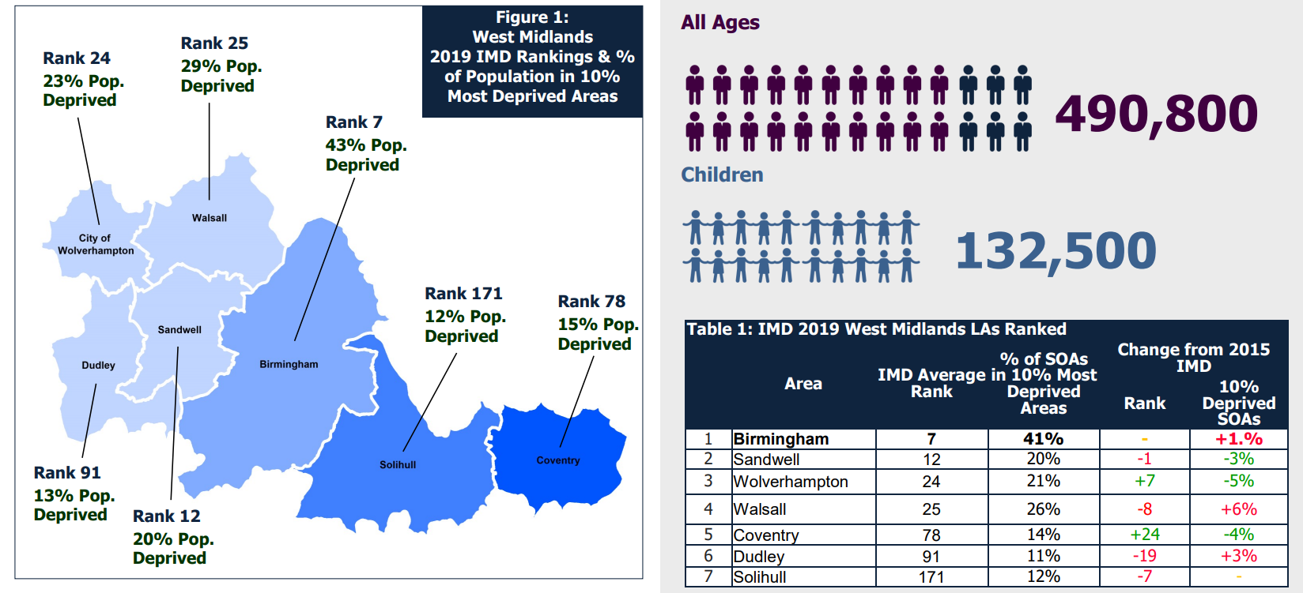
How the West Midlands compares:

Slide 12
Regional TfWM cost of living survey feedback overview
270 responses, September 2022.
Questions asked aimed to:
Gauge concerns around the rising cost of living and the impact it is having on citizen mental health and wellbeing.
Gain insight into actions taken as a result of the rising cost of living.
Anticipate future concerns and how these might be mitigated.
Test levels of optimism towards the economy and mental health within the region and local communities.
Notes:
About a temperature check of current and future concerns rather than generalisable findings given numbers

Slide 13
Survey feedback - Main Impacts on Mental Health / Wellbeing
The main impact on mental wellbeing was increased stress/worry/depression as a result of the current rising cost of living (42%). Others were concerned for the future/up-coming winter months (18%), were feeling emotionally/mentally drained due to having to plan ahead/constantly monitor their budget (12%)
I live in constant anxiety with the fear of not having money to pay bills or buy food.
It makes me anxious. However, this will get worse as winter comes, as I won't be able to afford to heat my house.
Constantly worrying when spending. Not able to plan social events or holidays to look forward to. Worrying long term about ability to buy a home.
Question: Please provide details of how the current rising cost of living is impacting on your mental wellbeing? Base 200 respondents. % exceeds 100% due to multiple responses
Notes:
As a reaction to the cost of living respondents were most likely to be doing more of the following: switching to lower priced food (80%), looking for offers (75%), switching to discount stores (64%) and minimising travel (62%).
They were doing less of the following: Turing the heating on (80%), socialising (62%), participating in health and wellbeing activities (59%) and carrying out house maintenance (58%).
Older respondents, families and those on modest/high incomes were more likely to travel less. Younger respondents and those on lower incomes were more likely to switch to discount stores.

Slide 14
Survey feedback: Effect on Mental Wellbeing in next 12 months
Two fifths (40%) of respondents thought that they’d become more stressed/anxious/scared/depressed over the next 12 months due to the rising cost of living, with a further 12% thinking that their mental health and wellbeing would deteriorate/worsen. 1 in 10 hoped their mental health would be unaffected, or thought it was difficult to comment.
More worried / stressed, possibly less nutritious or varied diet, feeling cold at home
Worsened. Less money to spend on food & physical activities (e.g.. gym, exercise classes) = declining physical health. Stress causing more mental health issues
I will eat less and that will affect me physically and mentally. The stress of worrying about bills will be increased.
Question: Thinking about the next 12 months, how do you think your physical health, mental health, and/or wellbeing may be affected by the cost of living increases? Base 171 respondents. % exceeds 100% due to multiple responses

Slide 15
OPCC feedback - Emerging crime implications
More theft
Increased sex work (sorting to sex work; forced into sex work; sex for rent);
Rising child exploitation;
Increasing substance misuse / addictions as a coping mechanism;
Increased loan shark activity;
Increased domestic violence

Slide 16
Feedback from MH Commission discussions – thematic areas
Opportunities to increase income
Opportunities to reduce costs
Additional mitigating actions

Slide 17
Opportunities to increase income
Living wage accreditation:
encourage key organisations to pursue it (Birmingham City Council is already accredited and also strongly supports the agenda);
Encourage key organisations to use leverage / ‘soft power’ on contractors to pursue accreditation;
Opportunities to learn from work in London, etc. to
Consider applicability to all adults
Link to ICS health inequalities strategies and ‘people’ strategies –
promote skills development,
Skills development and career opportunities
reducing discriminatory barriers to recruitment, retention and progression (e.g. Walsall Housing Group has successfully worked with NHS Trusts and local colleges to improve recruitment and retention – looking at advertising, language used, etc.
Job guarantees for long-term unemployed people and those with long-term social care support

Slide 18
Opportunities to increase income
Social Value in Procurement
Systematic use of procurement levers to promote social value goals linked to distributing income to communities / community organisations;
More effective use in public sector – myth busting, promoting progressive Commissioner practice / reducing risk aversion (e.g. OPCC is a potential exemplar)
Supporting smaller communities organisations to form consortia, etc to bid for contracts;
Benefits take up
Advice and support to take up benefit entitlements, Healthy Start vouchers, etc. (E.g. Walsall Housing Group supported tenants to access £5.6m in benefits that they were entitled to but unclaimed).
Train and use local people to support benefits uptake and otherwise harnessing ‘community assets’;

Slide 19
Opportunities for cost reduction
Rent controls – explore their use, learning from Scotland, etc
Transport –
Subsidised and / or free transport for young people up to age of 25;
Improve frequency of buses;
Support with travel costs to access work, education, training, etc.
Actions to promote active travel to support access to leisure centres, parks, etc.
Emergency funding for energy costs (75% of survey respondents)
Funding for food (67% of survey respondents).
Use Council Tax relief schemes to ensure people facing the biggest threats to their finances are not at risk from non-payment. We know that the West Midlands is the 3rd highest region for council tax arrears.

Slide 20
Other mitigating actions
Pursuit of genuinely affordable housing – strict / contractual levers to ensure delivery of good proportions of social housing in new housing developments; housing for key workers;
Energy efficient housing: more energy efficient genuinely affordable homes. Ongoing help for people to insulate their homes, reducing the costs of heating to those with the lowest incomes. There is evidence that having a warm home has a direct and causal positive impact on mental health, with knock-on benefits to physical health.
Advocating for more timely and supportive benefits processes - impact of Disability Living Allowance backlog / PIP reviews
Funding to enable community advice services (delivered by VCS orgs), specifically supporting a local, physical presence and provision targeted to highly vulnerable sections of the population.

