Slide 1
Using behavioural science to nudge residents to access income support
Updated January 2024
Early Intervention and Prevention

Slide 2
Introduction:
Delivered a pilot to understand how behavioral science supports prevention, as part of WMCA funds which were awarded to the Early Intervention & Prevention Programme.
Nudge an identified cohort to access Income Maximisation services provided by Homes & Money Hub.
The key purpose of the pilot is to understand the mode of communication to respondents, their reactions and subsequent actions as a response to the messages delivered.

Slide 3
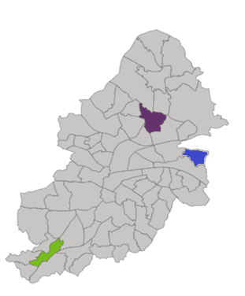
The cohort:
Internal data analysis indicated that Foodbank voucher assessment is one of the biggest reasons for citizen contact.
Strong relation between Foodbank voucher requests and accessing support for income related welfare instruments like Universal Credit, LWP Crisis Card, and in seeking Council Tax Support.
The cohort was identified from the Northfield and Shard End ward who have already contacted the council for foodbank vouchers.
The cohort used either Web or both Web and Contact Centre as their medium of contact.
Northfield and Shard End are selected as part of place-based approach due to resource, including staff support.

Slide 4
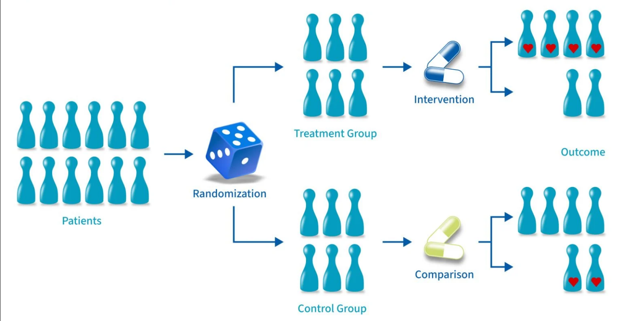
Place-based Trial:
Northfield and Shard End wards are identified as research locations for this pilot in line with a place-based approach.
Northfield and Shard End are identified as Group 1, where the intervention (nudge messages) would be taking place.
Erdington would be Group 2 where the regular help and support would be offered to citizens, except the intervention.
The responses to the intervention would be documented to understand the implications of interventions, which will be compared between both groups for an in-depth analysis.
Place-based Approach
Northfield & Shard End
Group 1
Citizens
Erdington
Group 2

Slide 5
The Ceteris Paribus:
The biggest criticism towards experiments (control trails) is the criteria of selection towards treatment and control groups.
In this case, as we are not implementing any direct benefit (monetary) (or) declining anyone to access the existing services, we can claim that we are not excluding anyone from exercising their social rights.
Like mentioned above, we attempt to keep every operation related to HaM the same (like the current model), and we experiment the intervention at the treatment ward.
The above all conditions establish that, all other conditions at both the wards are same while conducting the pilot, i.e., Ceteris Paribus

Slide 6
The Intervention:
Intervention
The Nudge messages have been developed as part of the intervention.
These messages would be distributed via SMS (GOV.UK Notify)
The respondents who say ‘yes’ will receive a phone call by a HaM staff member re. Income Max support
Those who do not respond will receive a follow-up email to see if interest is secured using a different mode of communication
Yes
No
Frame nudge messages
No Intervention
Nudge messages sent to respondents
Respondents contacted by HaM
Evaluation
Evaluation

Slide 7
Evaluation:
The situation post intervention would be calculated using the responses the advisor notes when the citizen attend HaM.
The qualitative interviews with Group 2 (Erdington) would further reveal the impact of the intervention as Group 1 individuals would narrate how it would have helped them.
Upon collecting these evaluations and responses from both groups the pilot can capture the learnings and document them.
Group 1 (Northfield & Shard End) responses to intervention
Group 2 (Erdington) Qualitative Research
Further qualitative responses
Analysing the learnings
Documenting the learnings

Slide 8
The Nudge messaging

Slide 9
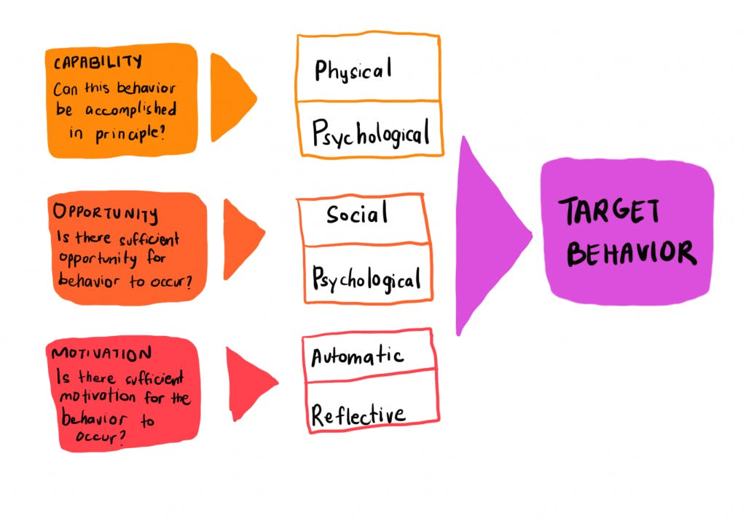
The COM-B model and SCALE approach – application of behavioural science
Specify Be specific about what you are asking people to do
Consider Explore the barriers and facilitators of the COM-B model
Assemble Write your content
Layout Consider your layout
Evaluate Plan your evaluation

Slide 10
Learning from SCALE-led Focus group
Communication Method | Target Audience | Current Behaviour | Intended Behaviour | How to do | Actual Messages
 | Who are currently in crisis, foodbank users, rent arrears, In temporary accommodation, In financial problems, Range of experiences, Have barriers (digital exclusion), Lack of knowledge and skills, Have past bad experiences, Physical barriers like disability and neurodiverse, have family members and peers as support, Range of identities, by religion, culture and ethnicity. | Stressed and worried, Language barriers in accessing services, Not in helpful situations, Individual/circumstantial responses and acknowledging those responses, Lack of experience, knowledge, and ability to self-help, Dependent on others, Stigma, Lack of information, Dealing with complexity of systems, Fear, and lack of trust Not of all of them have skills, reading and writing, linguistic skills as a barrier, varied awareness, some doesn’t recognise barriers | Self-help and seek early support and help, Having knowledge and being motivated, confident, video messages | Can instil trust, Encourage people to access support, Easy, timely, and assured service, Success testimonials, examples Hope and trust, Taking the stigma out Ask about other issues that are affecting the citizen Using the benefits services as a motivation Reality driven operations (managing expectations) Translation skills and accessibility Understand (explaining) digital products | Recognising themselves: Dear (First Name), Are you worried about rising Energy and Food costs and your well-being? Normalising the challenge: We know that many of us are struggling with cost-of-living crisis. The support we offer: If you are worried about how to make ends meet, or know someone who is, you can reach out and have a conversation with us. Motivation through a relatable case-study: The success testimonial (case study examples from pilot learnings and locale and generic) Nudging them towards accessing the service

Slide 11
The Nudge Message:
Preliminary message from a BCC display number:
Dear ((First name)) ((Last name)), in the next hour you will receive a message from Birmingham City Council's Homes and Money Advice team on 07860 034 456 (please note this number does not accept calls). This is a new service which has been set up to provide financial support to individuals and households in the city.
Main text message:
Recognising themselves: Dear ((First name)) ((Last name)), Are you worried about rising Energy, Food costs and your well-being?
Normalising the challenge: We know that many of us are struggling with the cost-of-living crisis.
The support we offer: If you are worried about your financial situation, or know someone who is, you can reach out and have a conversation with us.
Motivation through a relatable case-study (include in email version only): In the past 6 months, our team has helped 128 households by connecting them to benefits and welfare support …(case study examples from pilot learnings - local and generic). The testimonials using the simulations (ex: ‘x’ number of people have used this service, we identified ‘x’ amount of unclaimed benefits)
Nudging them towards accessing the service: If you are interested in finding out more, please reply ‘YES’ and someone will get back to you within five working days. Reply 'NO' to opt out, and to stop receiving further messages. Thanks, Homes and Money Advice Hub
Trust the source of the message: This a no-cost service offered by Birmingham City Council which you can verify here: https://www.birmingham.gov.uk/cost-of-living

Slide 12
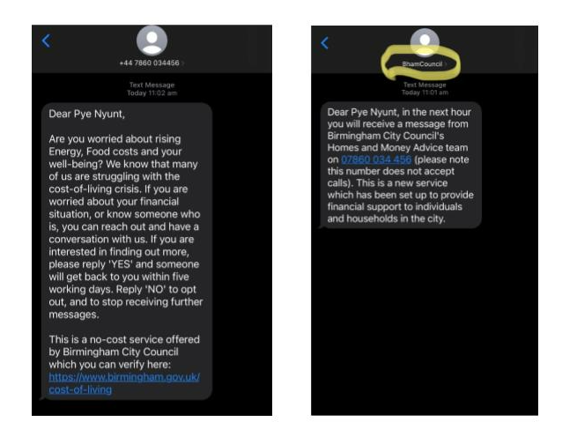
The message
Notes:
Example of the message

Slide 13
Results and Impact

Slide 14
Behavioural Science Pilot results - Total
Construct | Count
Total citizens in cohort | 170
Citizen falls into category of ‘Phone/email not accepting messages right now’ and ‘Phone/email does not exist’ | 54
Total number of active citizens in cohort | 116
Response received | Number of unique citizens | Total percentage
Total response | 43/116 | 37%
Yes | 39/116 | 33.6%
No | 4/116 | 3.4%
No response | 73/116 | 63%
Over £94,000 estimated income maximisation being achieved, with the highest ranging from £21k-11k per individual, and an average of £3270 per individual

Slide 15
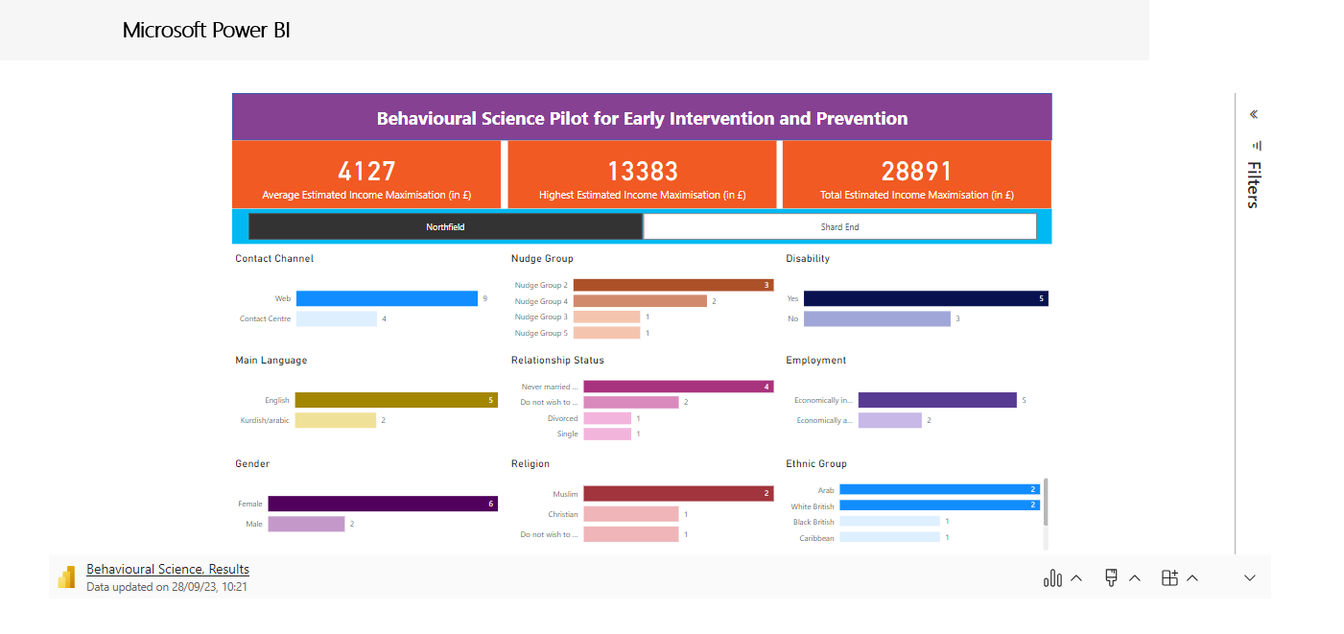
Notes:
17 of the 39 individuals were registered as disabled but not known to (nor currently in need of) adult social care. Supporting these 17 individuals to remain financially resilient and outside of statutory adult social care services is a cost avoidance of £1.32m per annum (the average cost of disability support in care settings is £1,500 to the council). The value of early intervention to the wider public service system would be much greater.

Slide 16
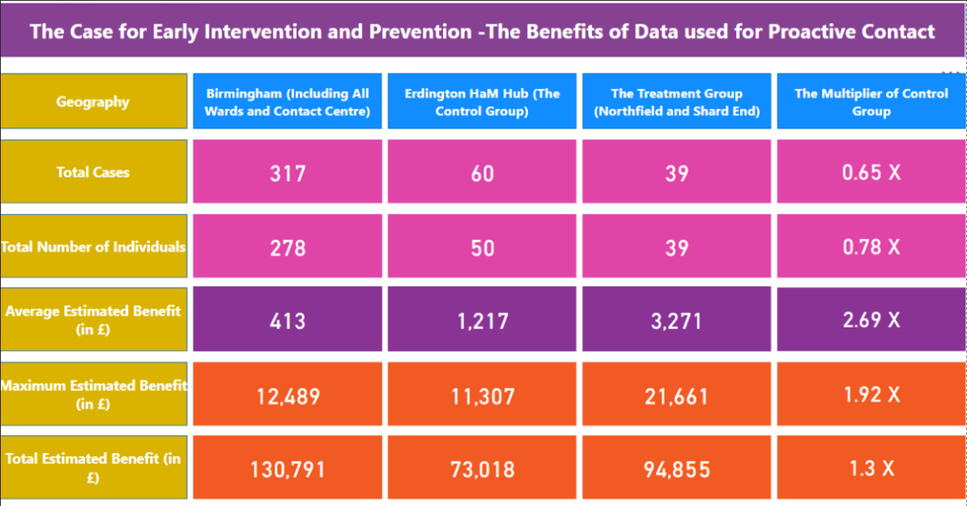

Slide 17
Next Steps

Slide 18
Emerging findings and recommendations
Development of further cohorts that will involve using other key datasets (beyond foodbank vouchers) such as rent and council tax arrears – as determined by the service through learning from the pilot
Award application submission for the behavioural science pilot

